Slide 1
Module - 6
Data warehousing
data warehousing concepts and definitions,
data warehousing process overview,
data warehousing architecture, data warehouse development,
real-time data warehousing,
data warehouse administration and security issues,
OLTP Vs OLAP .

Slide 2
Data Warehousing concepts and definitions

Slide 3
Data Warehousing
A Data warehouse is repository of information collected from multiple sources, stored under a unified schema, and that usually resides at a single site.
Data Warehouse: a centralized data repository which can be queried for business benefit.

Slide 4
Client
Data source in India
Clean
Integrate
Transform
Load
Refresh
Query & Analysis Tools
Data source in New York
Data Warehouse
Client
Data source in Japan
Data source in China

Slide 5
A data warehouse is a subject-oriented, integrated, time-variant, and nonvolatile collection of data in support of management’s decision-making process.”—W. H. Inmon
Data warehousing:
The process of constructing and using data warehouses

Slide 6
Characteristics of Data Warehousing
subject-oriented,
integrated,
time-variant,
nonvolatile

Slide 7
Data Warehouse—Subject-Oriented
Organized around major subjects, such as customer, product, sales rather than day to day operations and transactions
Focusing on the modeling and analysis of data for decision makers, not on daily operations or transaction processing
Provide a simple and concise view around particular subject issues by excluding data that are not useful in the decision support process

Slide 8
Data Warehouse—Integrated
Constructed by integrating multiple, heterogeneous data sources
relational databases, flat files, on-line transaction records
Data cleaning and data integration techniques are applied.
Ensure consistency in naming conventions, encoding structures, attribute measures, etc. among different data sources
E.g., Hotel price: currency, tax, breakfast covered, etc.
When data is moved to the warehouse, it is converted.

Slide 9
Data Warehouse—Time Variant
The time horizon for the data warehouse is significantly longer than that of operational systems
Operational database: current value data
Data warehouse data: provide information from a historical perspective (e.g., past 5-10 years)
Every key structure in the data warehouse
Contains an element of time, explicitly or implicitly
But the key of operational data may or may not contain “time element”

Slide 10
Data Warehouse—Nonvolatile
A physically separate store of data transformed from the operational environment
Operational update of data does not occur in the data warehouse environment
Does not require transaction processing, recovery, and concurrency control mechanisms
Requires only two operations in data accessing:
initial loading of data and access of data

Slide 11
Some additional characteristics may include the following:
Web based- Data warehouses are typically designed to provide an efficient computing environment for Web-based applications.
Relational/multidimensional- A data warehouse uses either a relational structure or a multidimensional structure.
Client/server- A data warehouse uses the client/ server architecture to provide easy access for end users.

Slide 12
Real time- Newer data warehouses provide real-time, or active, data-access and analysis capabilities
Include metadata- A data warehouse contains metadata (data about data) about how the data are organized and how to effectively use them.

Slide 13
What can business analysts gain from having a data warehouse?
Competitive advantage
Productivity
Customer relationship management
Cost reduction

Slide 14
Three types of Data Warehouses
Enterprise data warehouse (EDW)
collects all of the information about subjects spanning the entire organization
Data Marts
a subset of corporate-wide data that is of value to a specific groups of users. Its scope is confined to specific, selected groups, such as marketing data mart
Independent vs. dependent (directly from warehouse) data mart
Virtual warehouse (operational data stores-ODS)
A set of views over operational databases
Only some of the possible summary views may be materialized

Slide 15
An Enterprise Data warehouse collects information about subjects that span an entire organization and thus its scope is enterprise wide.
A Data Mart is a department subset of a data warehouse. It focuses on selected subjects, thus its scope is department wide
A data mart is a smaller, more focused data warehouse. It reflects the business rules of a specific business unit.

Slide 16
The Data Mart is More Specialized
The data mart serves the needs of one business unit, not the organization.
Finance
Data Mart
Sales
Data Mart
Marketing
Data Mart
Accting
Data Mart
Organizational
Data
Warehouse

Slide 17
A data mart can be either dependent or independent.
A dependent data mart is a subset that is created directly from the data warehouse.
It has the advantages of using a consistent data model and providing quality data.
A dependent data mart ensures that the end user is viewing the same version of the data that is accessed by all other data warehouse users.
Disadvantage: The high cost of data warehouses limits their use to large companies.

Slide 18
As an alternative, many firms use a lower-cost, scaled-down version of a data warehouse referred to as an independent data mart.
An independent data mart is a small warehouse designed for a department or strategic business unit (SBU), but its source is not an EDW.

Slide 19
Metadata Repository
Metadata is data about data.
Metadata is the data defining warehouse objects.
Metadata describe the structure of and some meaning about data, thereby contributing to their effective or ineffective use.
Pattern is another way to view metadata.
According to the pattern view, we can differentiate between syntactic metadata (i.e., data describing the syntax of data), structural metadata (i.e., data describing the structure of the data), and semantic metadata (i.e., data describing the meaning of the data in a specific domain).

Slide 20
Metadata Repository should contain(it stores):
Description of the structure of the data warehouse
schema, view, dimensions, hierarchies, derived data defn, data mart locations and contents
Operational meta-data
data lineage (history of migrated data and transformation path), currency of data (active, archived, or purged), monitoring information (warehouse usage statistics, error reports, audit trails)
The algorithms used for summarization
The mapping from operational environment to the data warehouse
Data related to system performance
warehouse schema, view and derived data definitions
Business data
business terms and definitions, ownership of data, charging policies

Slide 21
OLTP Vs OLAP

Slide 22
Most people are familiar with commercial relational database systems, it is easy to understand what a data warehouse is by comparing these two kinds of systems.
The major task of on-line operational database systems is to perform on-line transaction and query processing.
These systems are called on-line transaction processing (OLTP) systems.
They cover most of the day-to-day operations of an organization, such as purchasing, inventory, manufacturing, banking, payroll, registration, and accounting.

Slide 23
Data warehouse systems, on the other hand, serve users or knowledge workers in the role of data analysis and decision making.
Such systems can organize and present data in various formats in order to accommodate the diverse needs of the different users.
These systems are known as on-line analytical processing (OLAP) systems.

Slide 24
Online Transaction Processing(OLTP)
Deals with operational data, which is data involved in the operation of a particular system.
The main emphasis for OLTP systems is put on very fast query processing and effectiveness is measured by number of transactions per second.
In an OLTP system, the data is frequently updated and queried.
To prevent data redundancy and to prevent update anomalies the database tables are normalized.
Eg: In a banking System, you withdraw amount through an ATM. Then account number, ATM PIN number, Amount you are with drawing and Balance amount in account are operational data elements.

Slide 25
Online Analytical Processing(OLAP)
Deals with Historical Data and it is characterized by relatively low volume of transactions.
Queries needed for these systems are often very complex
The response time is an effectiveness measure
Example: If we collect last 10 years data about flight reservation, the data can give us much meaningful information such as the trends in reservation. This may give useful information like peak time of travel, and what kinds of people are travelling in the various classes available

Slide 26
Online Analytic Processing (OLAP): provides more complex queries than OLTP.
OLAP operations use background knowledge regarding the domain of the data being studied in order to allow the presentation of data at different levels of abstraction.
Such operations accommodate different user viewpoints.

Slide 27
OLAP Operations include:
Roll-up- it involves summarizing the data along a dimension. [The summarization rule might be computing totals along a hierarchy or applying a set of formulas such as "profit = sales – expenses”]
Drill-down/Up - allow the user to view the data at differing degrees of summarization. Drill Down/Up allows the user to navigate among levels of data ranging from the most summarized (up) to the most detailed (down)

Slide 28
Slice and Dice
Slice is the act of picking a rectangular subset of a cube by choosing a single value for one of its dimensions, creating a new cube with one fewer dimension
Dice: The dice operation produces a sub-cube by allowing the analyst to pick specific values of multiple dimensions

Slide 29
Roll up (drill-up): summarize data
by climbing up hierarchy or by dimension reduction
Drill down (roll down): reverse of roll-up
from higher level summary to lower level summary or detailed data, or introducing new dimensions
Slice and dice: project and select
Pivot (rotate):
reorient the cube, visualization, 3D to series of 2D planes
Other operations
drill across: involving (across) more than one fact table
drill through: through the bottom level of the cube to its back-end relational tables (using SQL)

Slide 30
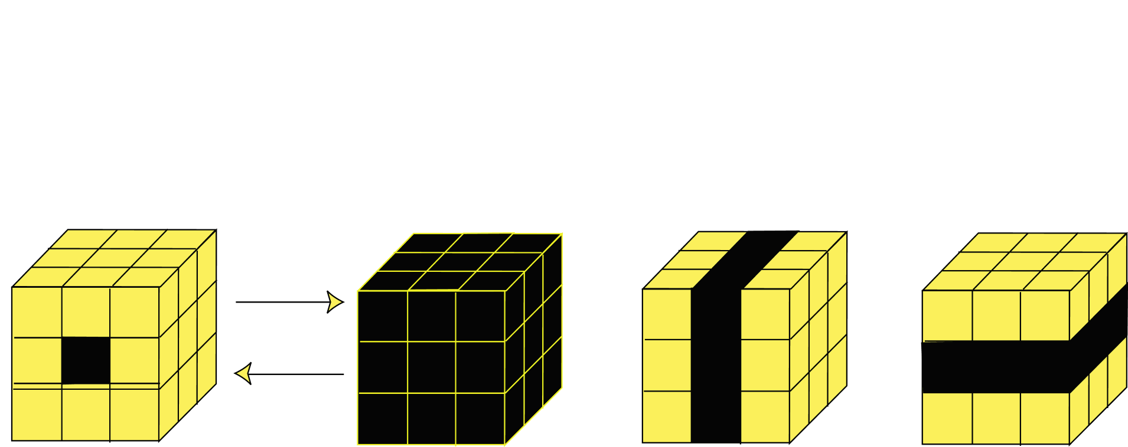
OLAP Operations
Roll Up
Drill Down
Single Cell
Multiple Cells
Slice
Dice
Data Mining: May use OLAP queries.

Slide 31
Comparison between OLTP & OLAP Systems

Slide 32
The major distinguishing features between OLTP and OLAP are summarized as follows:
Users and system orientation: An OLTP system is customer-oriented and is used for transaction and query processing by clerks, clients, and information technology professionals.
An OLAP system is market-oriented and is used for data analysis by knowledge workers, including managers, executives, and analysts.
Data contents: An OLTP system manages current data that, typically, are too detailed to be easily used for decision making.
An OLAP system manages large amounts of historical data, provides facilities for summarization and aggregation, and stores and manages information at different levels of granularity. These features make the data easier to use in informed decision making.

Slide 33
Database design: An OLTP system usually adopts an entity-relationship (ER) data model and an application-oriented database design.
An OLAP system typically adopts either a star or snowflake model and a subject-oriented database design.
Access patterns: The access patterns of an OLTP system consist mainly of short, atomic transactions. Such a system requires concurrency control and recovery mechanisms.
However, accesses to OLAP systems are mostly read-only operations (because most data warehouses store historical rather than up-to-date information), although many could be complex queries.

Slide 34
View: An OLTP system focuses mainly on the current data within an enterprise or department, without referring to historical data or data in different organizations.
In contrast, an OLAP system often spans multiple versions of a database schema, due to the evolutionary process of an organization. OLAP systems also deal with information that originates from different organizations, integrating information from many data stores. Because of their huge volume, OLAP data are stored on multiple storage media.

Slide 35
Data Warehouse vs. Operational DBMS
OLTP (on-line transaction processing)
Major task of traditional relational DBMS
Day-to-day operations: purchasing, inventory, banking, manufacturing, payroll, registration, accounting, etc.
OLAP (on-line analytical processing)
Major task of data warehouse system
Data analysis and decision making
Distinct features (OLTP vs. OLAP):
User and system orientation: customer vs. market
Data contents: current, detailed vs. historical, consolidated
Database design: ER + application vs. star + subject
View: current, local vs. evolutionary, integrated
Access patterns: update vs. read-only but complex queries

Slide 36
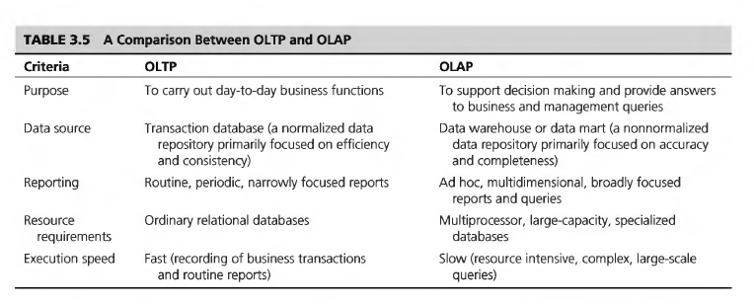

Slide 37
OLTP vs. OLAP

Slide 38
Representation of Data in Data Warehouse
Modeling data warehouses: dimensions & measures
Star schema: A fact table in the middle connected to a set of dimension tables
Snowflake schema: A refinement of star schema where some dimensional hierarchy is normalized into a set of smaller dimension tables, forming a shape similar to snowflake
Fact constellations: Multiple fact tables share dimension tables, viewed as a collection of stars, therefore called galaxy schema or fact constellation

Slide 39
Example of Star Schema
time
time_key
day
day_of_the_week
month
quarter
year
item
item_key
item_name
brand
type
supplier_type
Sales Fact Table
time_key
item_key
branch_key
branch
location
location_key
branch_key
branch_name
branch_type
location_key
street
city
state_or_province
country
units_sold
dollars_sold
avg_sales
Measures

Slide 40
Example of Snowflake Schema
time
item
time_key
day
day_of_the_week
month
quarter
year
item_key
item_name
brand
type
supplier_key
supplier
Sales Fact Table
supplier_key
supplier_type
time_key
item_key
branch_key
branch
location
location_key
location_key
street
city_key
branch_key
branch_name
branch_type
units_sold
dollars_sold
city
city_key
city
state_or_province
country
avg_sales
Measures

Slide 41
Example of Fact Constellation
time
time_key
day
day_of_the_week
month
quarter
year
item
Shipping Fact Table
item_key
item_name
brand
type
supplier_type
Sales Fact Table
time_key
time_key
item_key
shipper_key
item_key
branch_key
from_location
branch
location_key
location
to_location
branch_key
branch_name
branch_type
units_sold
location_key
street
city
province_or_state
country
dollars_cost
dollars_sold
units_shipped
avg_sales
shipper
Measures
shipper_key
shipper_name
location_key
shipper_type

Slide 42
From Tables and Spreadsheets to Data Cubes
A data warehouse is based on a multidimensional data model which views data in the form of a data cube
A data cube, such as sales, allows data to be modeled and viewed in multiple dimensions
Dimension tables, such as item (item_name, brand, type), or time(day, week, month, quarter, year) describes the dimension.
Fact table contains the names of the facts or measures (such as dollars_sold) and keys to each of the related dimension tables (facts are numerical measures)

Slide 43
Cube: A Lattice of Cuboids
all
0-D(apex) cuboid
time
item
location
supplier
1-D cuboids
time,location
item,location
location,supplier
time,item
2-D cuboids
time,supplier
item,supplier
time,location,supplier
3-D cuboids
time,item,location
time,item,supplier
item,location,supplier
4-D(base) cuboid
time, item, location, supplier

